Slide 1

Geometry
Unit 7, Lesson 6 Special Right Triangles Volume 1, pg. 400

Slide 2


Benchmark
MA.912.T.1.2
Solve mathematical and real-world problems involving right triangles using trigonometric ratios and the Pythagorean Theorem.
volume 1, pg. 400

Slide 3
Integrated Mathematical Thinking and Reasoning Standards
MA.K12.MTR.1.1 Actively participate in effortful learning both individually and collectively.
MA.K12.MTR.2.1 Demonstrate understanding by representing problems in multiple ways.
MA.K12.MTR.3.1 Complete tasks with mathematical fluency.
MA.K12.MTR.4.1 Engage in discussions that reflect on the mathematical thinking of self and others.
MA.K12.MTR.5.1 Use patterns and structure to help understand and connect mathematical concepts.
MA.K12.MTR.6.1 Assess the reasonableness of solutions.
volume 1, pg. 400

Slide 4


Learning Targets
I can use side ratios of $45−45−90$ triangles to solve problems.
I can use side ratios of $30−60−90$ triangles to solve problems.
volume 1, pg. 400

Slide 5

Warm-Up
volume 1, pg. 400

Slide 6

7.6.1 Warm-Up: Critical Thinking
What fraction of the shape is shaded?
Describe your problem-solving method.
volume 1, pg. 400

Slide 7

Exploration
volume 1, pg. 401

Slide 8

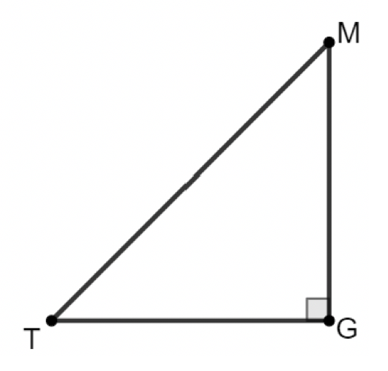
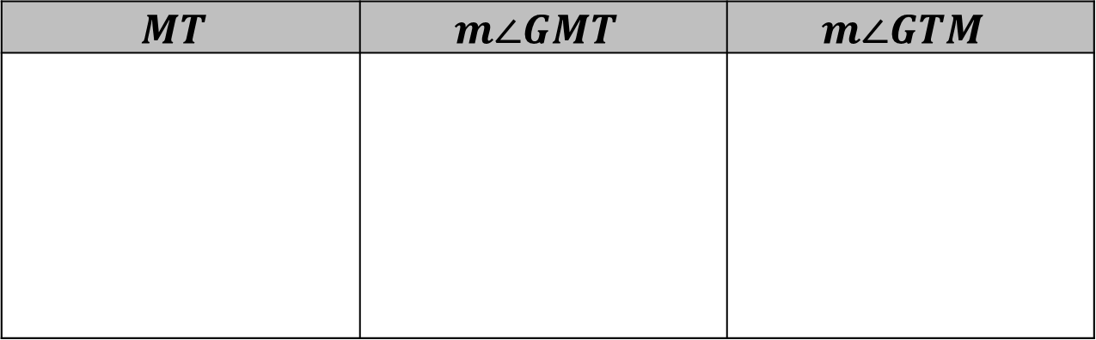
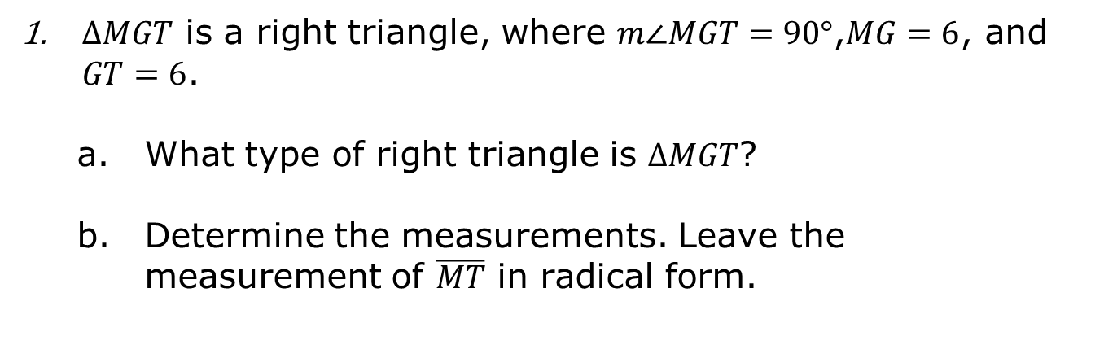
7.6.2 Exploration: Exploring Special Right Triangles
$∆MGT$ is a right triangle, where $m∠MGT=90°$,$MG=6$, and $GT=6$.
What type of right triangle is $∆MGT$?
Determine the measurements. Leave the measurement of $\overline{MT}$ in radical form.
$$MT$$ | $$m∠GMT$$ | $$m∠GTM$$
volume 1, pg. 401

Slide 9
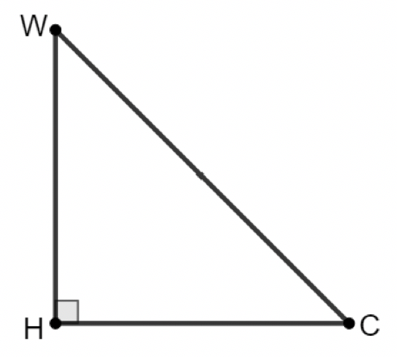
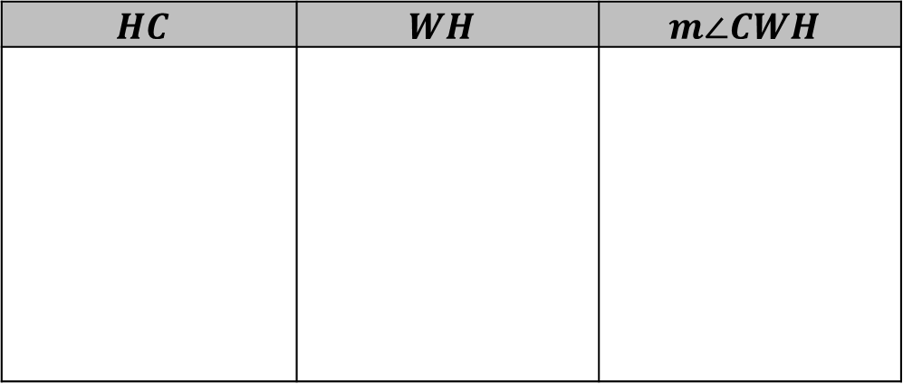
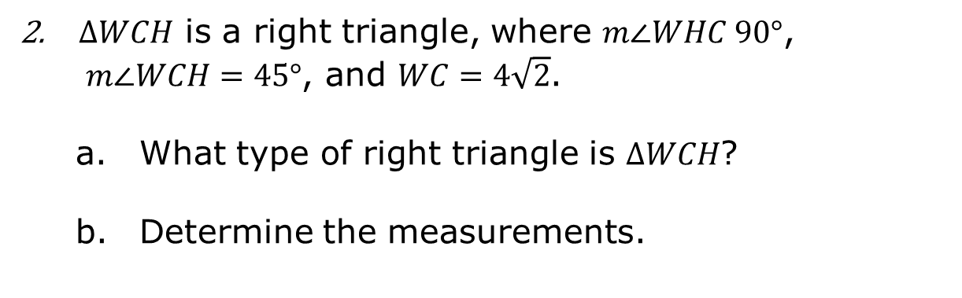
$∆WCH$ is a right triangle, where $m∠WHC 90°$, $m∠WCH=45°$, and $WC=4\sqrt{2}$.
What type of right triangle is $∆WCH$?
Determine the measurements.
$$HC$$ | $$WH$$ | $$m∠CWH$$
volume 1, pg. 401

Slide 10

What do you notice about the angles of $ΔWCH$ and $ΔMGT$?
What do you notice about the legs of $ΔWCH$ and $ΔMGT$?
volume 1, pg. 402

Slide 11
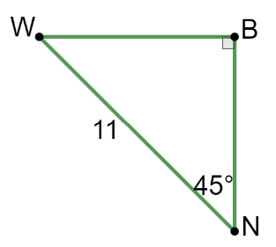
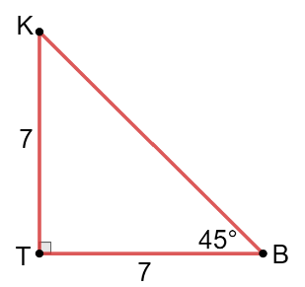
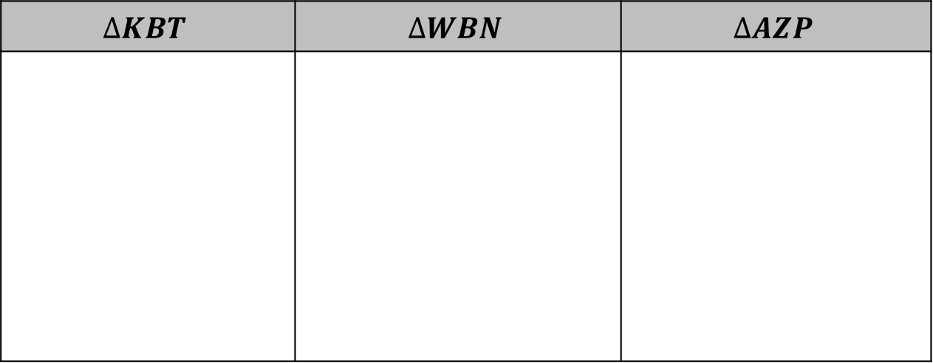
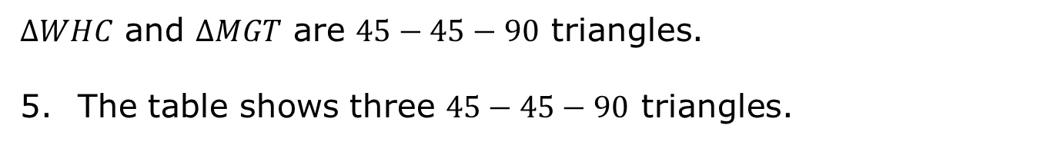

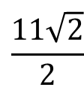

$∆WHC$ and $∆MGT$ are $45−45−90$ triangles.
The table shows three $45−45−90$ triangles.
$$∆KBT$$ | $$∆WBN$$ | $$∆AZP$$
$$3.6\sqrt{2}$$
$$7\sqrt{2}$$
$$\frac{11\sqrt{2}}{2}$$
volume 1, pg. 402

Slide 12
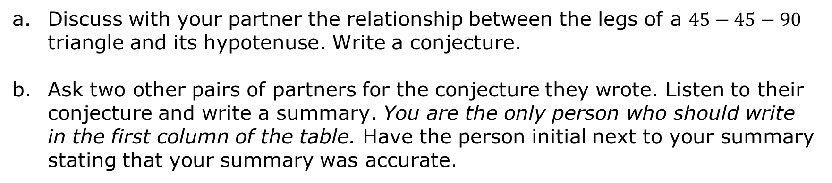
Discuss with your partner the relationship between the legs of a $45−45−90$ triangle and its hypotenuse. Write a conjecture.
Ask two other pairs of partners for the conjecture they wrote. Listen to their conjecture and write a summary. You are the only person who should write in the first column of the table. Have the person initial next to your summary stating that your summary was accurate.
Conjecture | Initials
volume 1, pg. 402

Slide 13
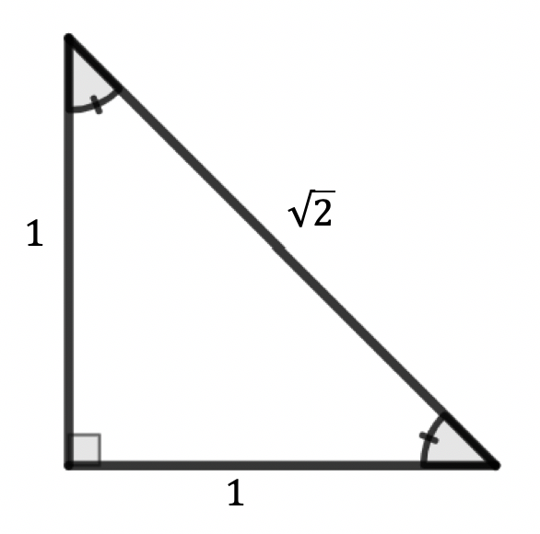

An isosceles right triangle is shown.
Describe how the triangle shows the relationships in a $45−45−90$ triangle.
volume 1, pg. 403

Slide 14
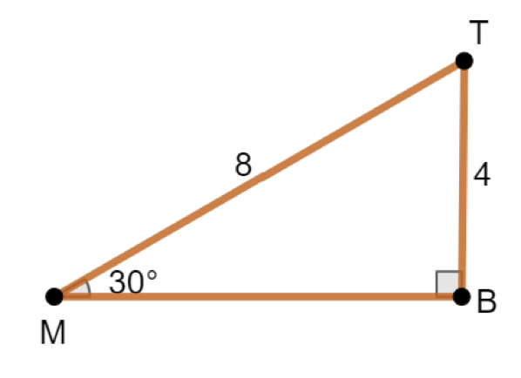

$∆MBT$ is a right triangle, where $m∠MBT=90°$, $m∠TMB=30°$,$TB=4$, and $MT=8$.
Find the length of $\overline{MB}$ using the Pythagorean Theorem. Write the answer in simplified radical form.
volume 1, pg. 403

Slide 15
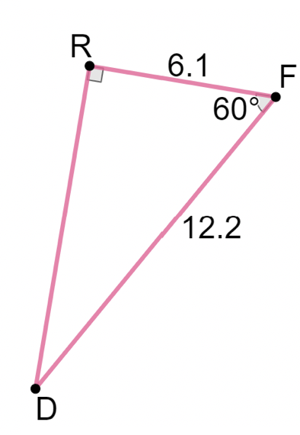

$∆RFD$ is a right triangle, where $m∠DRF=90°$, $m∠RFD=60°$, $RF=6.1$, and $FD=12.2$.
Discuss with your partner what features $∆RFD$ has in common with $∆MBT$.
volume 1, pg. 403

Slide 16
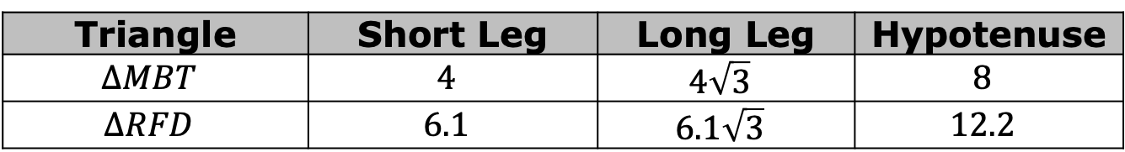
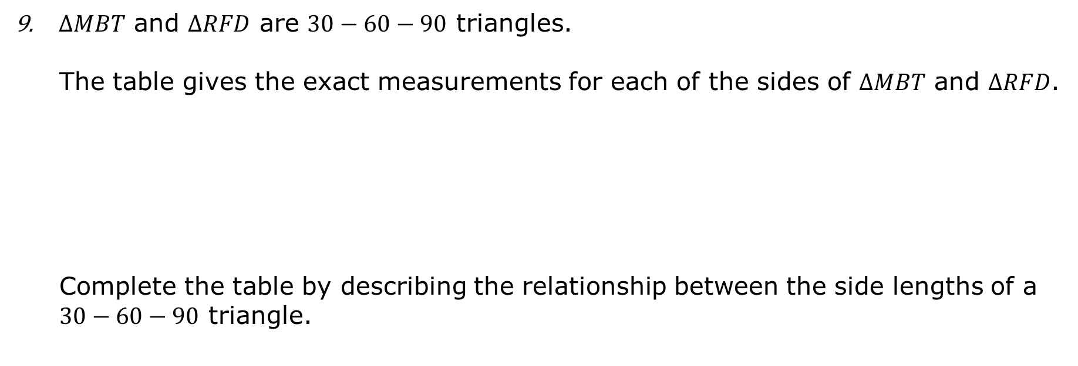
$∆MBT$ and $∆RFD$ are $30−60−90$ triangles.
The table gives the exact measurements for each of the sides of $∆MBT$ and $∆RFD$.
Complete the table by describing the relationship between the side lengths of a $30−60−90$ triangle.
Triangle | Short Leg | Long Leg | Hypotenuse
$$∆MBT$$ | $$4$$ | $$4\sqrt{3}$$ | $$8$$
$$∆RFD$$ | $$6.1$$ | $$6.1\sqrt{3}$$ | $$12.2$$
Sides | Relationship
short leg and hypotenuse
short leg and long leg
volume 1, pg. 404

Slide 17
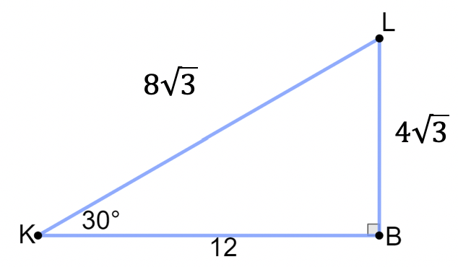

The table below includes three $30−60−90$ triangles.
$$∆KBL$$
volume 1, pg. 404

Slide 18
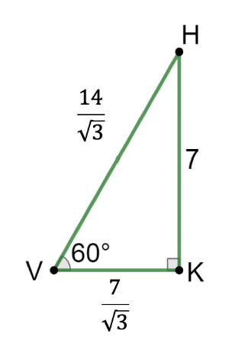
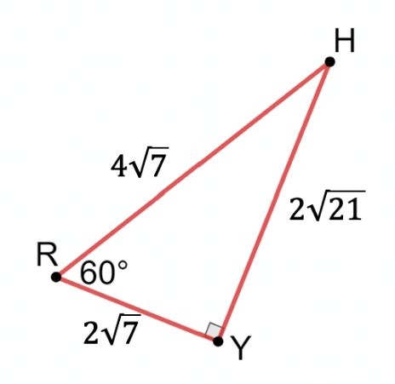
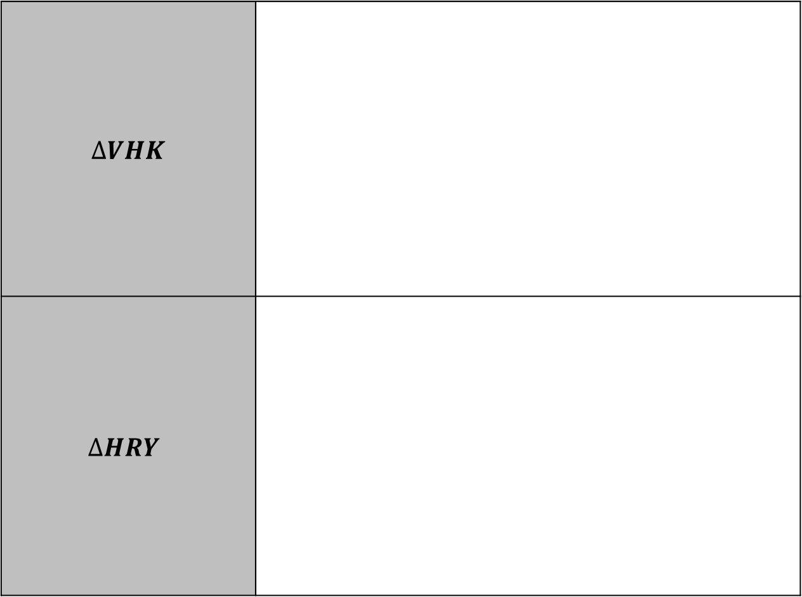
$∆VHK$
$$∆HRY$$
volume 1, pg. 404

Slide 19
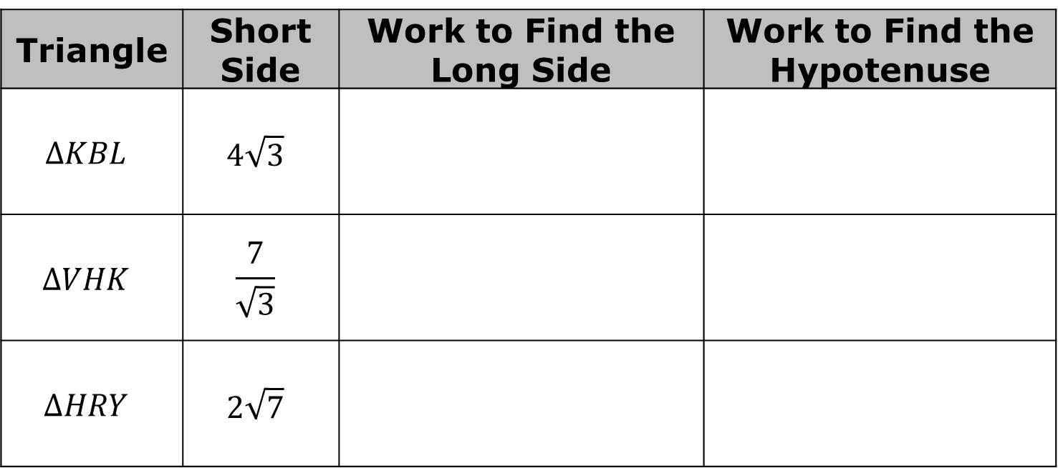
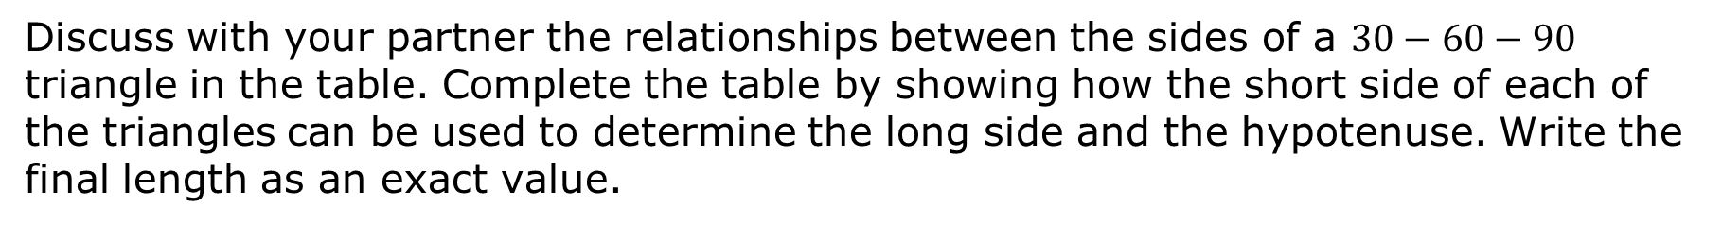
Discuss with your partner the relationships between the sides of a $30−60−90$ triangle in the table. Complete the table by showing how the short side of each of the triangles can be used to determine the long side and the hypotenuse. Write the final length as an exact value.
Triangle | Short Side | Work to Find the Long Side | Work to Find the Hypotenuse
$$∆KBL$$ | $$4\sqrt{3}$$
$$∆VHK$$ | $$\frac{7}{\sqrt{3}}$$
$$∆HRY$$ | $$2\sqrt{7}$$
volume 1, pg. 405

Slide 20
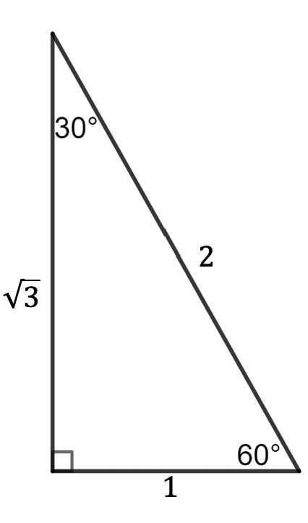
Describe how the triangle shows the relationships in a $30−60−90$ triangle.
volume 1, pg. 405

Slide 21

Guided Instruction
volume 1, pg. 405

Slide 22
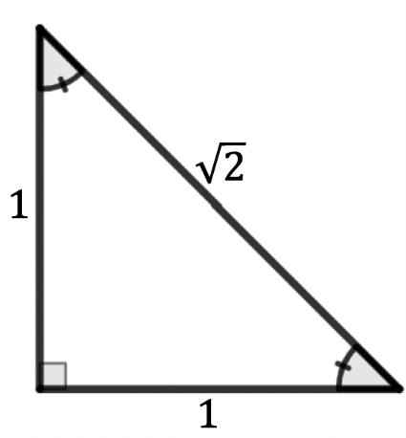

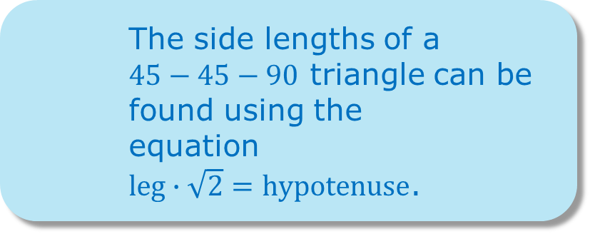
7.6.3 Guided Instruction: 45-45-90 and 30-60-90 Triangles
The side lengths of a
$45−45−90$ triangle can be found using the equation
$leg∙\sqrt{2}=hypotenuse$.
$ΔZYN$ has $m∠YZN=m∠YNZ=45°$, $m∠ZYN=90°$, and $ZN=12$. What are the lengths of the legs of the triangle? Leave your answer as an exact answer.
volume 1, pg. 405

Slide 23
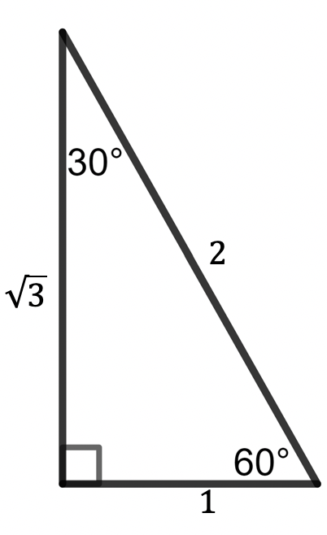
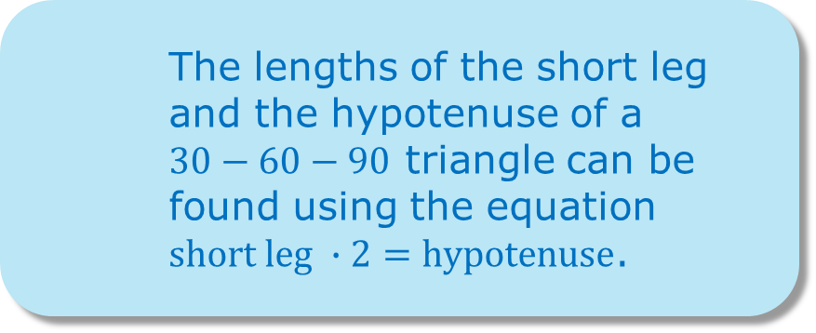
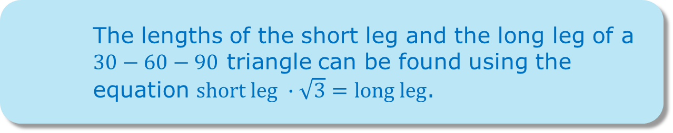
The lengths of the short leg and the long leg of a
$30−60−90$ triangle can be found using the equation $short leg ∙\sqrt{3}=long leg$.
The lengths of the short leg and the hypotenuse of a $30−60−90$ triangle can be found using the equation
$short leg ∙2=hypotenuse$.
volume 1, pg. 405

Slide 24
$ΔBHK$ is a $30−60−90$ triangle with $m∠KBH=30°$, $m∠BKH=90°$, and $BK=5\sqrt{3}$. What are the measures of the other sides of the triangle?
volume 1, pg. 406

Slide 25

Guided Practice
volume 1, pg. 406

Slide 26

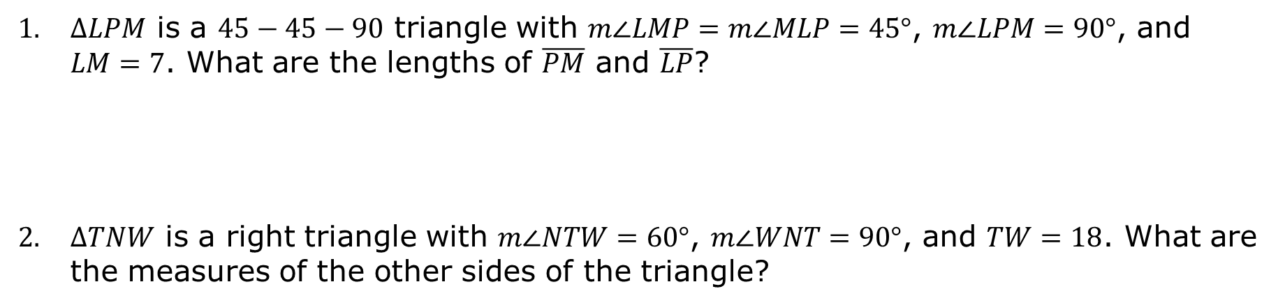
7.6.4 Guided Practice: Solving Special Right Triangles
$ΔLPM$ is a $45−45−90$ triangle with $m∠LMP=m∠MLP=45°$, $m∠LPM=90°$, and $LM=7$. What are the lengths of $\overline{PM}$ and $\overline{LP}$?
$ΔTNW$ is a right triangle with $m∠NTW=60°$, $m∠WNT=90°$, and $TW=18$. What are the measures of the other sides of the triangle?
volume 1, pg. 406

Slide 27

Wrap-Up
volume 1, pg. 407

Slide 28
7.6.5 Wrap-Up: Ticket Out the Door
$ΔFHX$ has angle measures $m∠HXF=90°$ and $m∠HFX=30°$, and side length $HX=6\sqrt{3}$. What are the exact measures of $\overline{FX}$ and $\overline{FH}$?
volume 1, pg. 407

